Slide 1

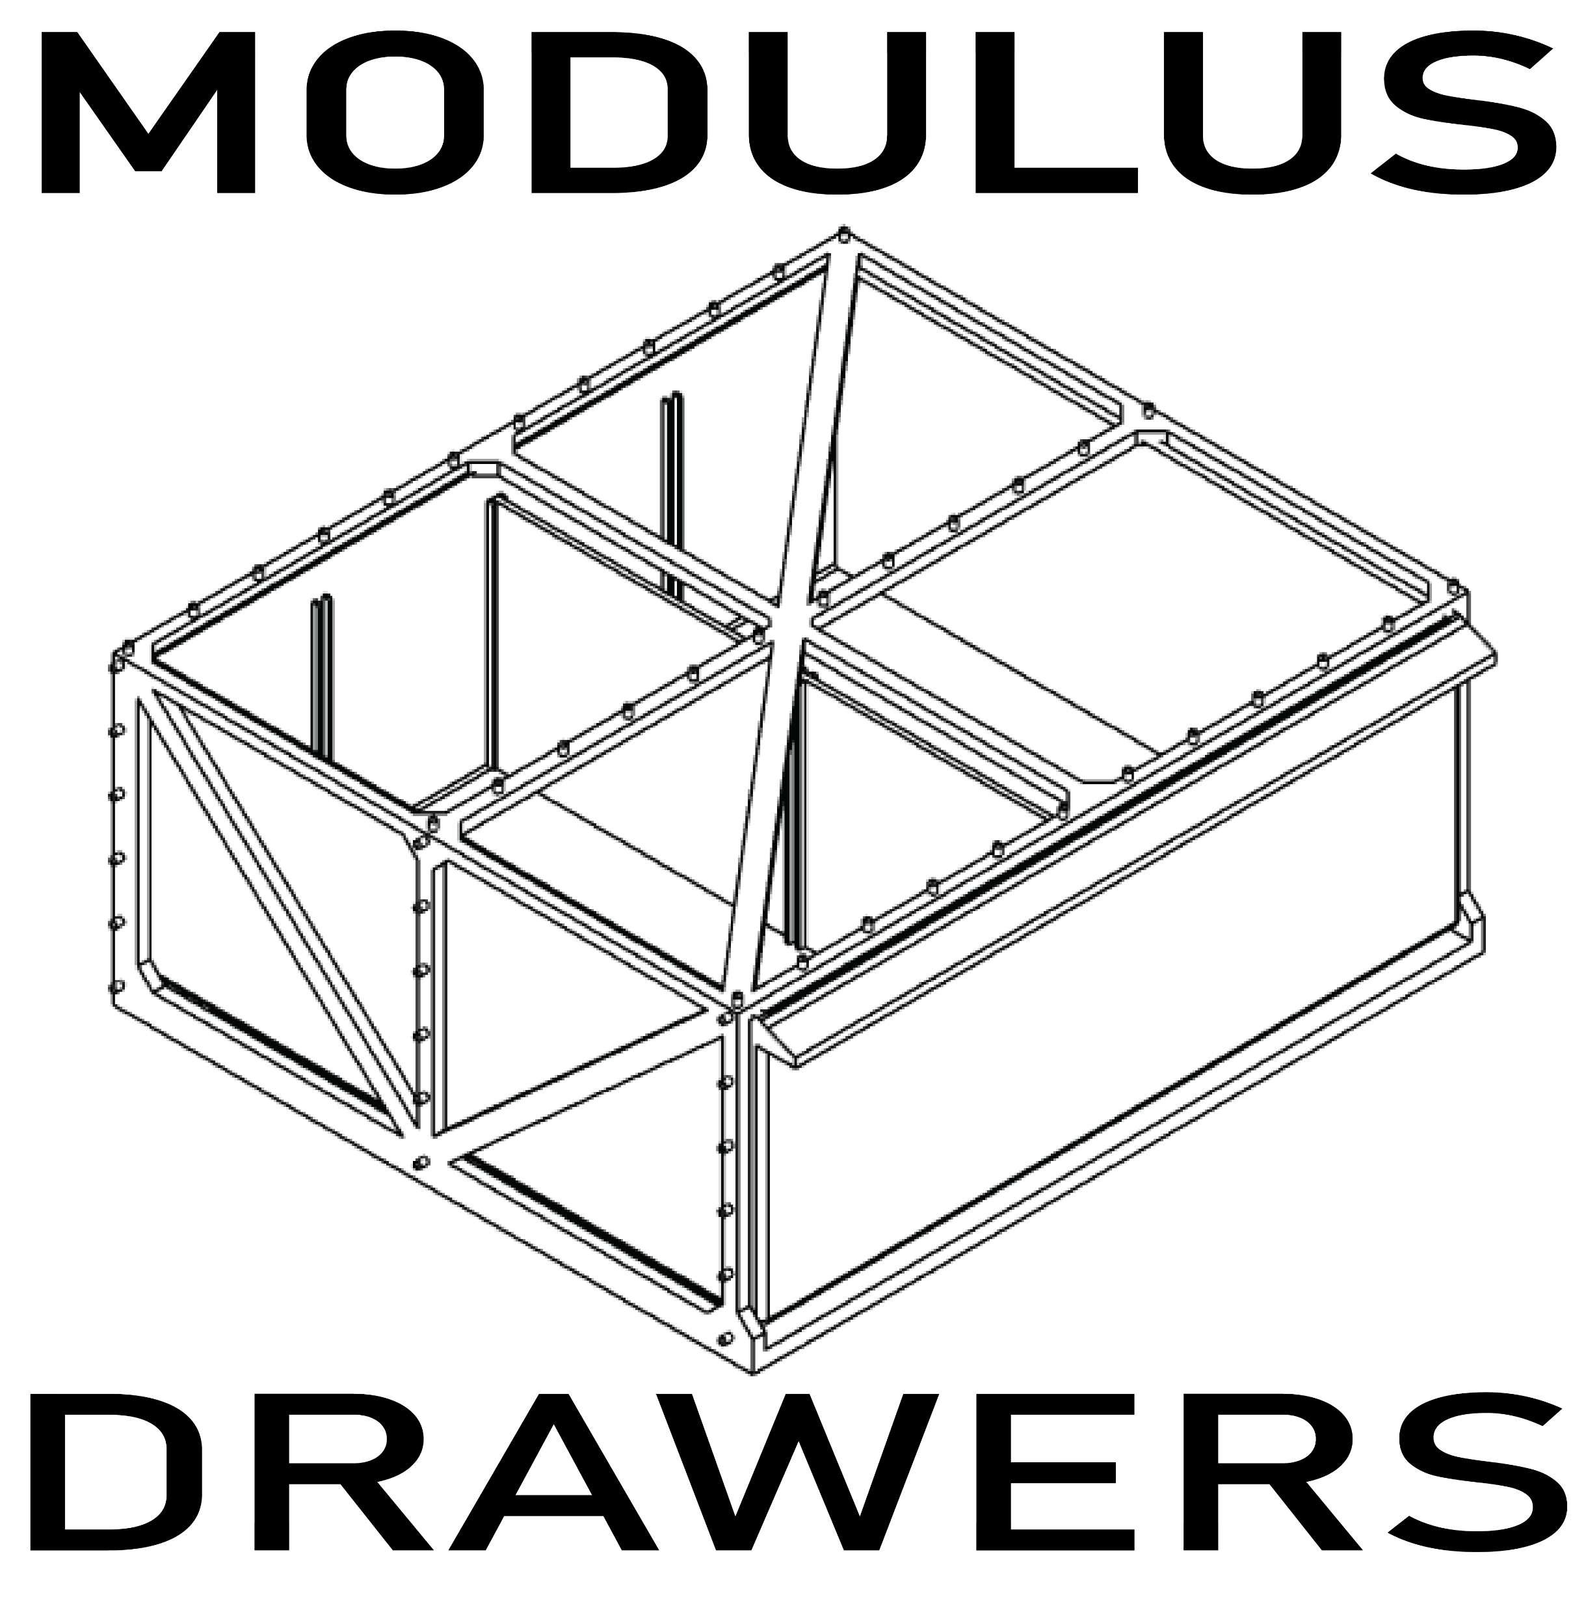
The Future of Customizable Storage
Scalable, Adaptable, Automated

Slide 2
Current Market Challenges
Traditional storage solutions are rigid and one-size-fits-all.
DIY storage requires technical knowledge and significant effort to set up.
Users face difficulty in organizing mixed collections (e.g., Lego, electronics, tools) effectively.

Slide 3
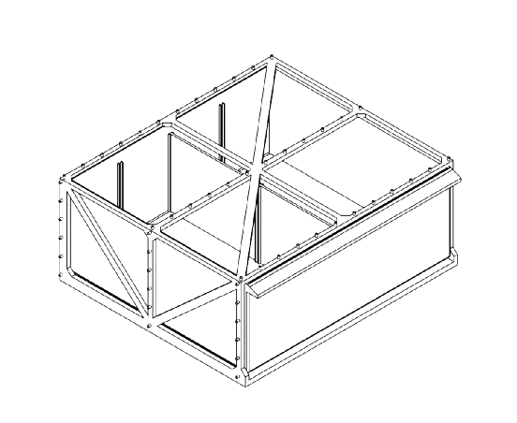
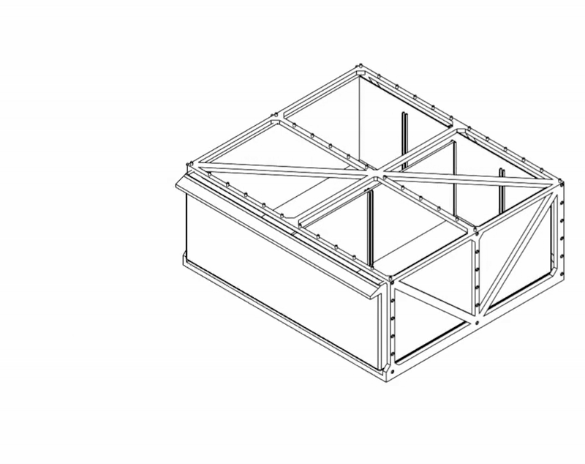
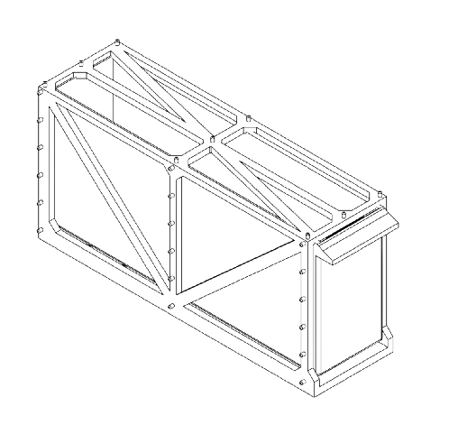
A Modular, Flexible Approach
To solve these issues, a completely modular and hands-free solution is needed. Modulus Drawers fills this niche by serving both DIY enthusiasts and motivated organizers alike.
Its scalable size allows it to fit virtually any item you wish to organize, perfectly. No more compromising with storage towers that only have a single size with dividers.
While on the product page, a configuration wizard will guide the user through the customization process, even automatically generating the optimal storage with a packing algorithm considering factors such as quantity, category, and geometry.
Hobbies and fields like Lego, electronics, engineering, arts, and automotive will benefit from the product’s flexible design, allowing it to become the universal organization solution for many different application areas.

Slide 4
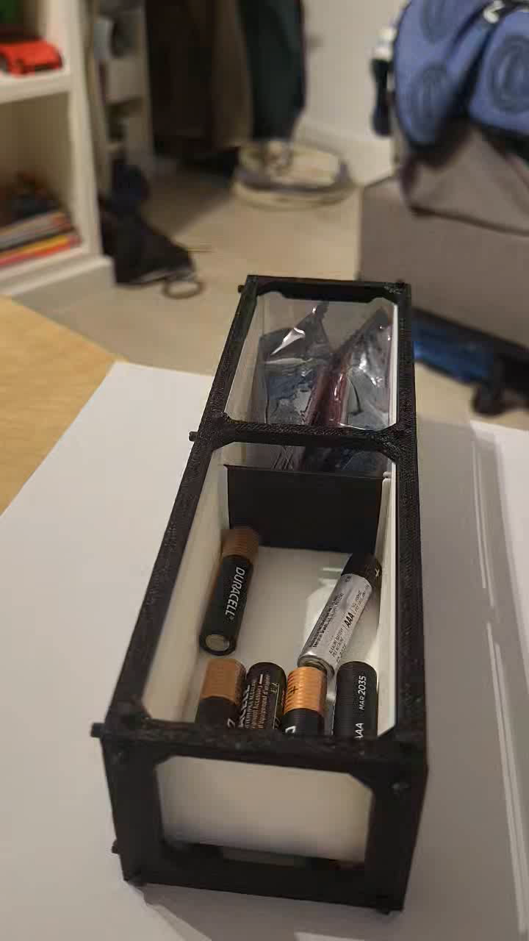
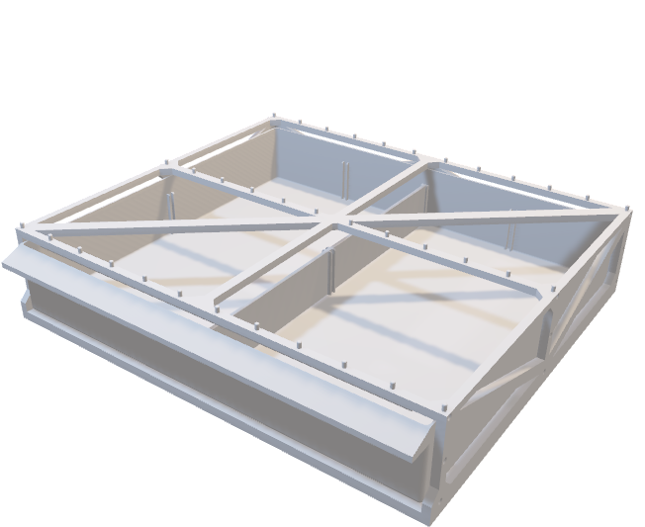
Functional Prototype
The current prototype demonstrates the product’s flexibility and function.
Further Prototypes will include more units to demonstrate how the drawers join to form a complete storage solution.

Slide 5
Other Features
The system will have an automatic product configurator, allowing users to sort entire part collections with a single click.
The physical system will be equipped with an optional addon that allows automatic sorting of items tossed into a collection bin.
A community hub will exist to share people’s own addons and modifications they have made for the system, allowing for the users themselves to provide extended value to the product.

Slide 6
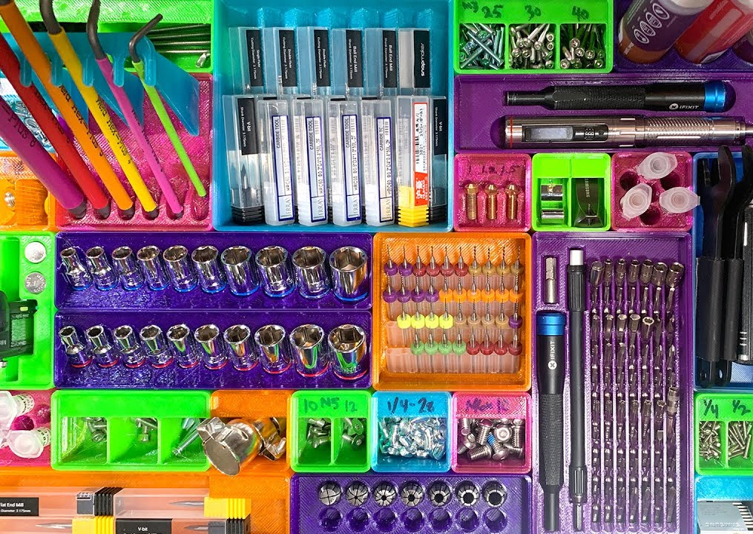
Gridfinity Support
Gridfinity is an open-source grid-based system for DIYers and enthusiasts to 3D print custom storage boxes. It has become a vibrant community, and ensuring support for it will add an extra layer of value to the product in the eyes of those who are already motivated to organize their stuff.

Slide 7
Questions? Comments
Fun Facts:
This is a real product I am developing.
I made it because I am very disorganized and lazy and want something to do it for me.
Its original intention was to sort my Lego, but I soon recognized its use beyond my original use case.
The model will be able to be injection molded in the future, preventing the overhead necessary with a 3D printed only design.
I plan to also make its customization be not only in width and height, but also depth.

