Slide 1

Tie Rod Tab
By: Aiden Kuemmerle

Slide 2
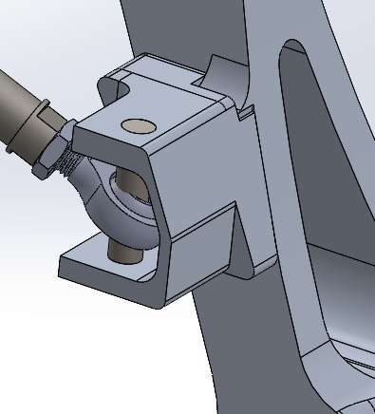
Tie Rod Tabs
Purpose:
Connects: Tie Rods to upright assembly.
Facilitates: Steering, alignment and possible heavy load transfer from the vehicle.
Goals and Considerations:
FOS: min of 1.657 at 2250 lbf axial load,(no replacements, difficult to repair)
Weight optimization (want to reduce unsprung mass)
In house CNC manufacturability while managing tight space constraints
Part geometry flows well with the upright assembly for aesthetics

Slide 3
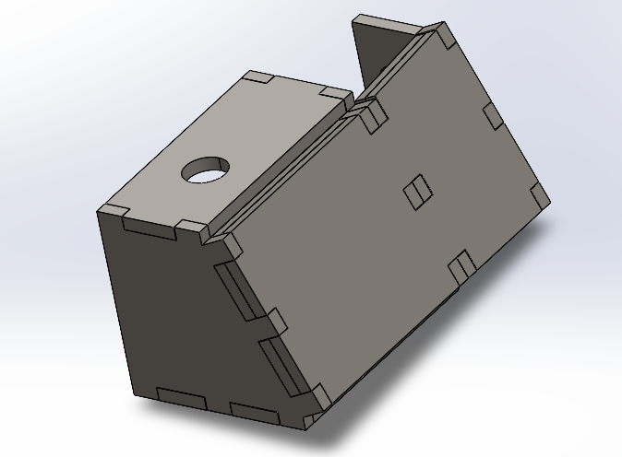
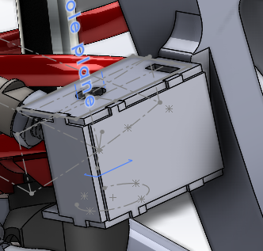
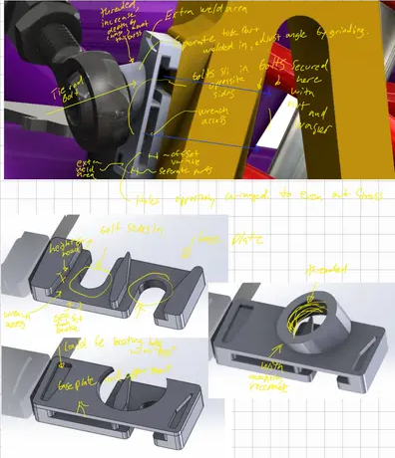
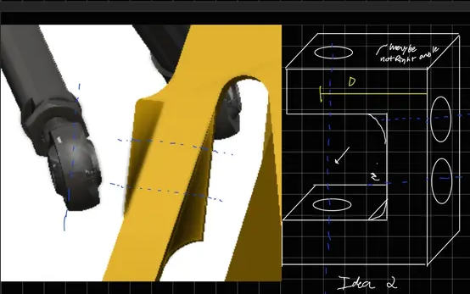
Many sometimes questionable designs…
4
3
1
2

Slide 4
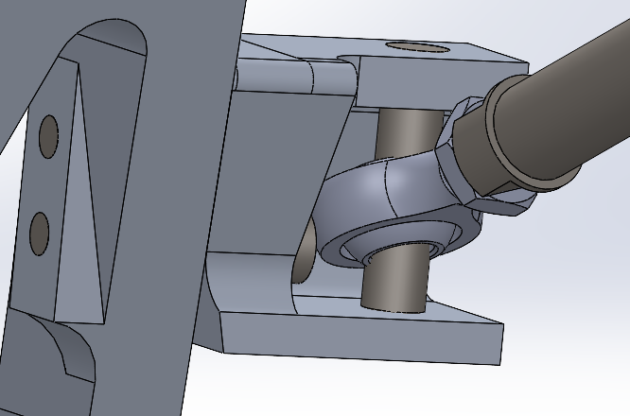
Tie Rod Tab - Final design
Material: Al 6061 T6
Weight: .28lbs
Number of setups: 4

Slide 5
Tie Rod Tab - Major Updates Overview
Switched from sheet metal to machined tab for better strength in a very cramped space
Removed Weight saving cuts as they saved minimal weight and the effort to do them was not justified
Changed Fillets around the part for DFM
Cleaned up angled faces so that they have continuous references

Slide 6
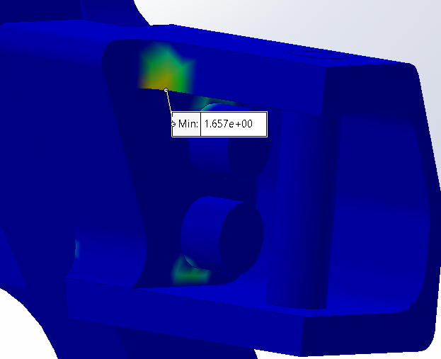
Tie Rod Tab - Load cases: Overview
Load: Full weight of the car + driver (340kg) + 3g impact = 10 KN (2250lbf)
Min FOS Aim: 1.2
FOS overview:
The Factor of Safety minimum location makes sense given the loading direction
High force load comes from force transfer through tie rod onto the tab
Results Analysis:
The part with weight savings matched the FOS goal more closely but with major part complexity issues.
The high load causes the screw heads and tie rods to be as close as possible together without interference in normal usefor the maximum amount of base stock to support the force.

Slide 7
Tie Rod Tab - Manufacturing
DFM with available tools found in the IGEN CNC tool library

Slide 8
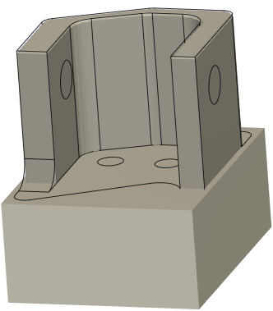
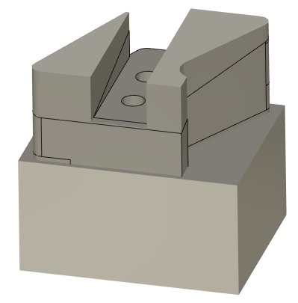
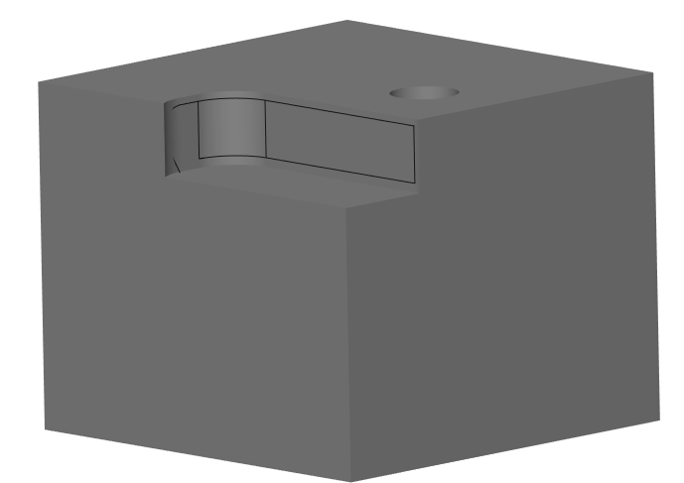
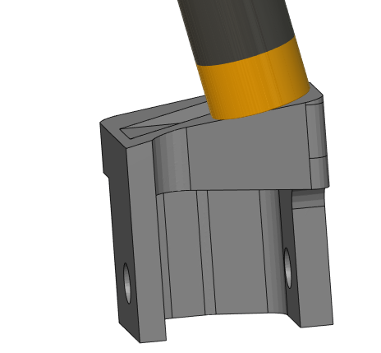
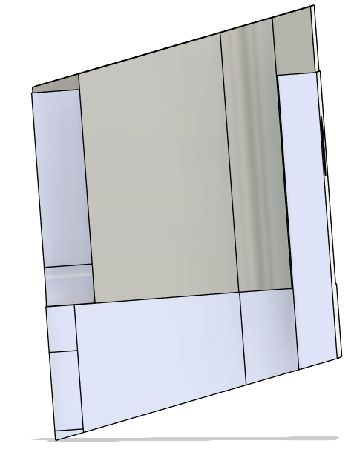
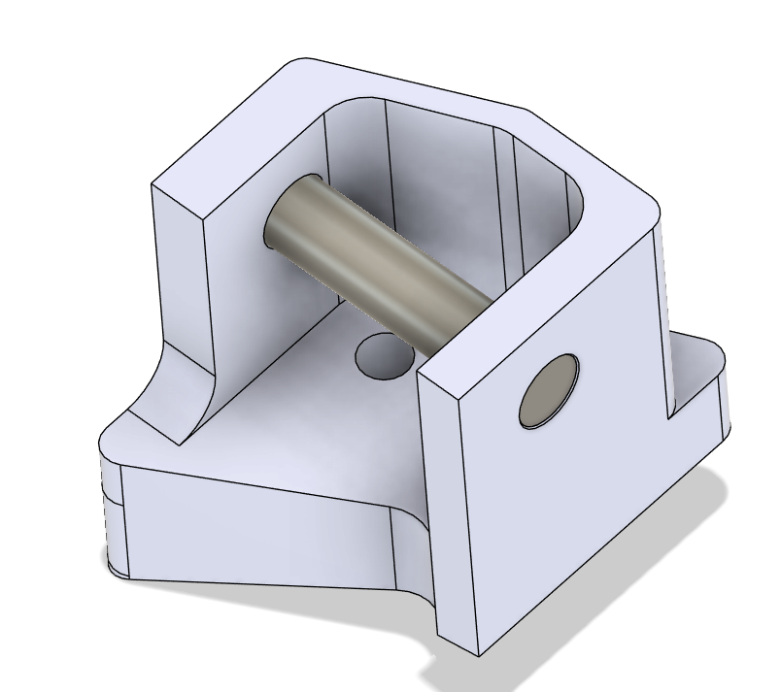
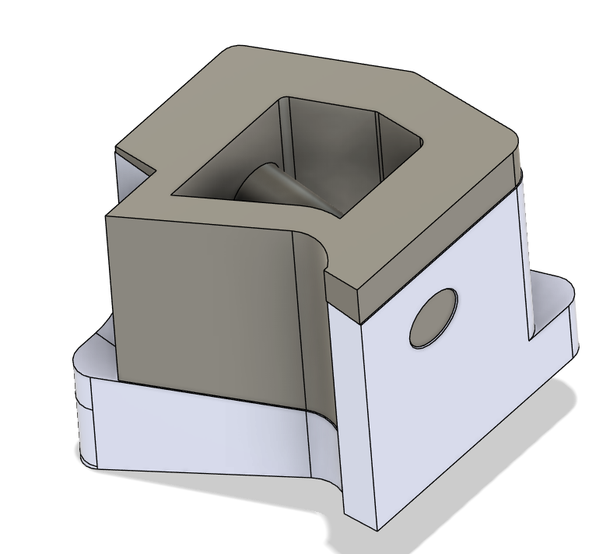
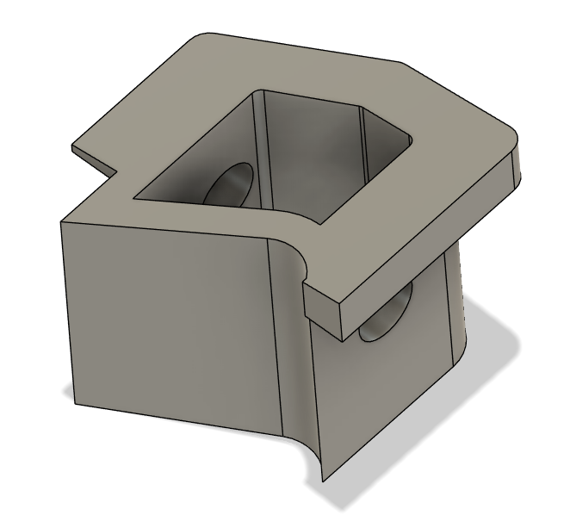
Tie Rod Tab - Manufacturing Plan
The operations in order left to right, the final operation requiring a 3d printed jig to hold the top angled surface flat for facing, using tools in the IGEN Alley.
The face is located by the jig as shown:

Slide 9
Tabs - Next steps
Do CAM for mirror side as self practice for me to learn it myself (Kento did the CAM for this)
Continue in-house manufacturing plan
Possibly more CNC practice
ABSOLUTELY confirm hardware sizes for tie rods and their clearance inside match the CAD

